Slide 1

Data Science Salary Analysis & Compensation Strategy
Presented by: Jalissa Horinek
Date: June 2025

Slide 2
Project overview
Objective:
Analyze global data science salaries to recommend a competitive compensation range.
Why it Matters:
Salaries are rising due to market competition; attracting top talent is critical for growth.
Key Questions Addressed:
What salary should we offer for a data scientist role?
How do U.S. salaries compare to offshore talent?
Does experience level or remote work impact pay?
Approach
Used real-world salary data across countries, job levels, and company sizes. Focused on full-time data science roles from recent years.

Slide 3
Data Summary
Source:
Global dataset of data science roles collected from 2020 to 2022.
Scope:
Covers salaries across various countries, experience levels, and job types in the data science field.
Variables Analyzed:
Salary (normalized to USD)
Experience level (Entry to Executive)
Remote work ratio (0%, 50%, 100%)
Company Size (Small, Medium, Large)
Employee location (U.S. vs global)
Filters Applied:
Focused on full-time data science roles to ensure consistency.

Slide 4
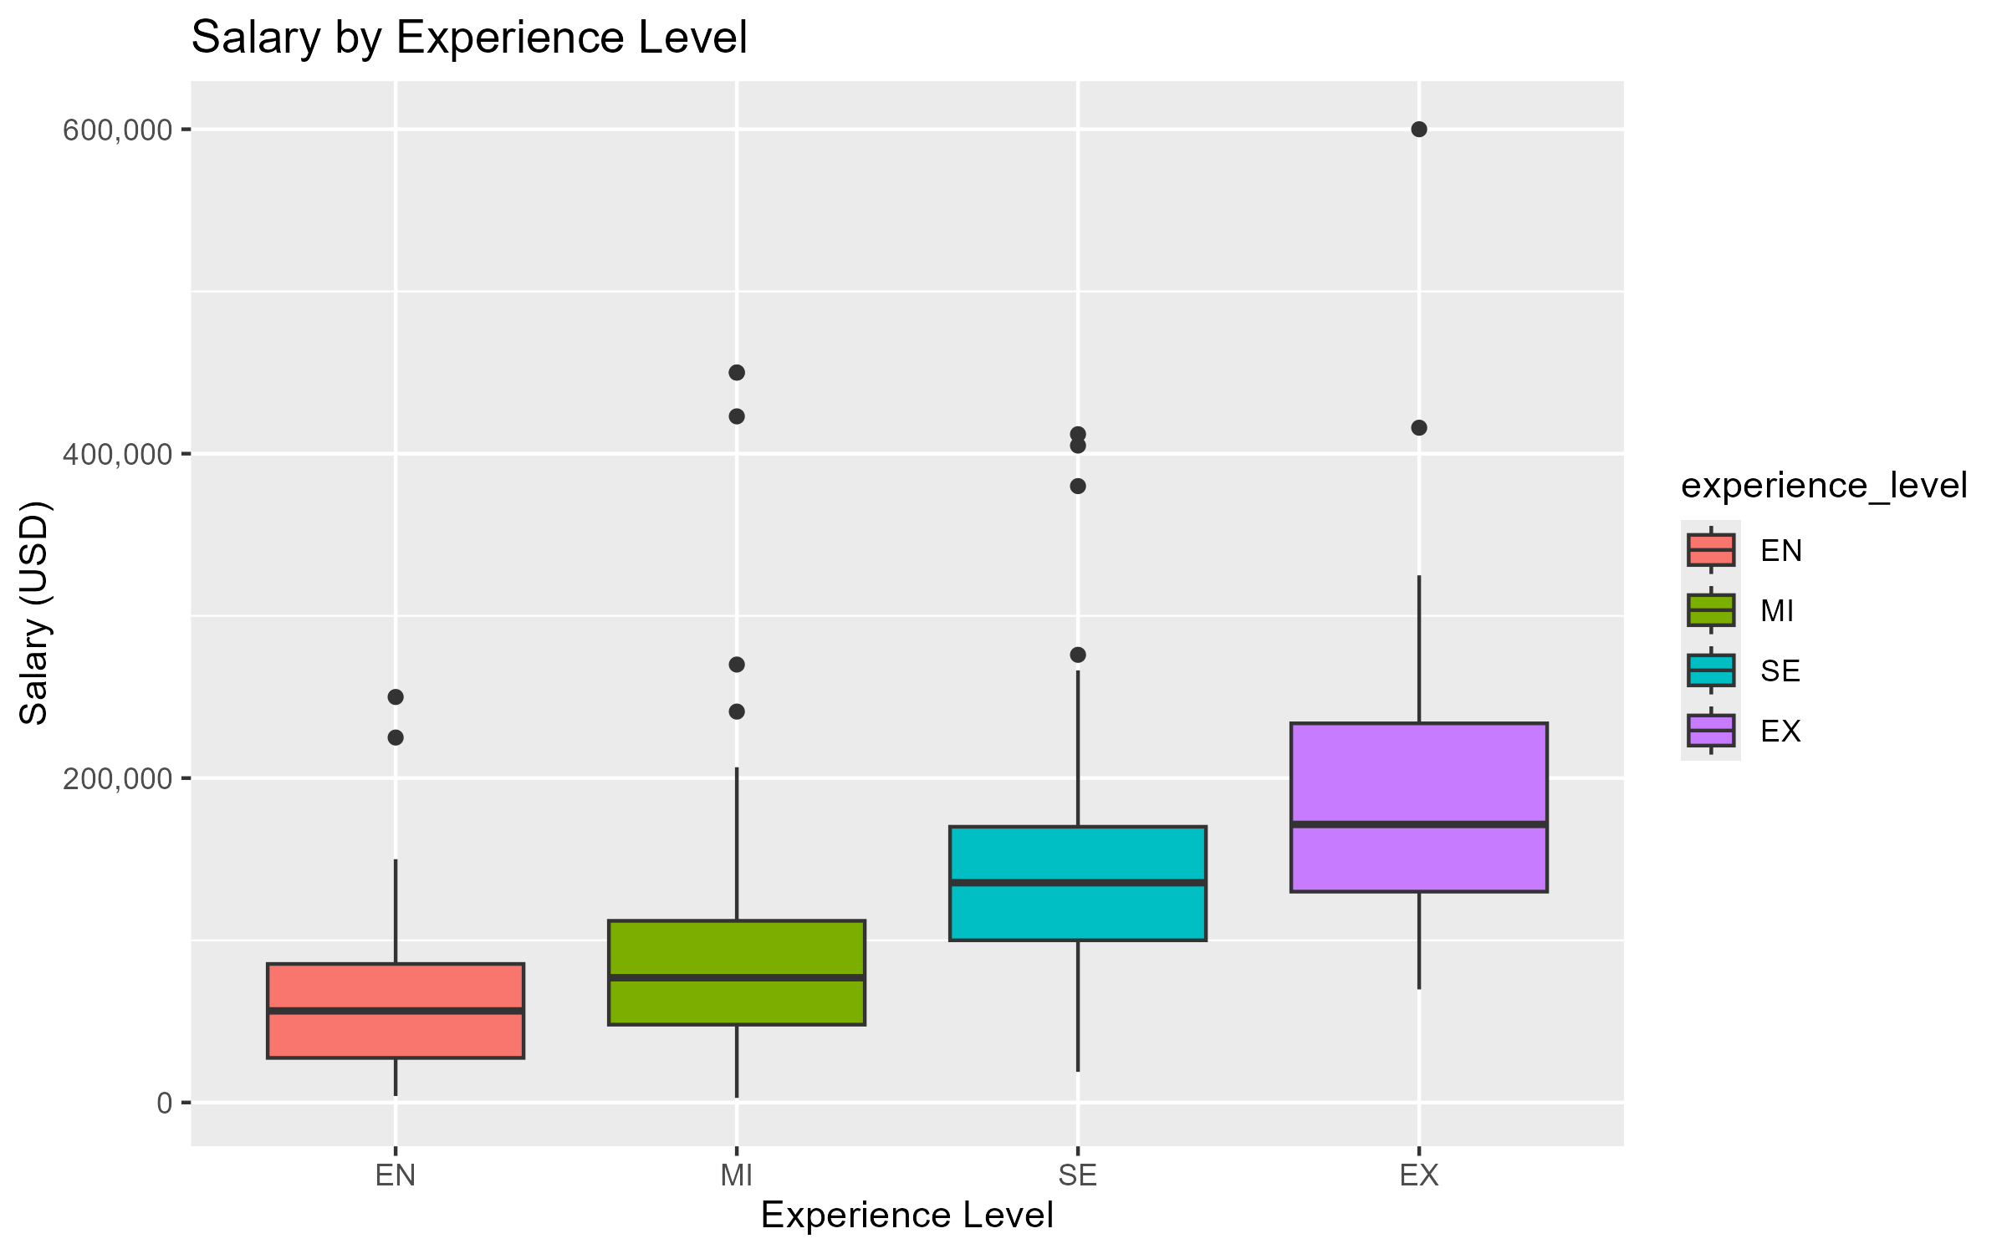
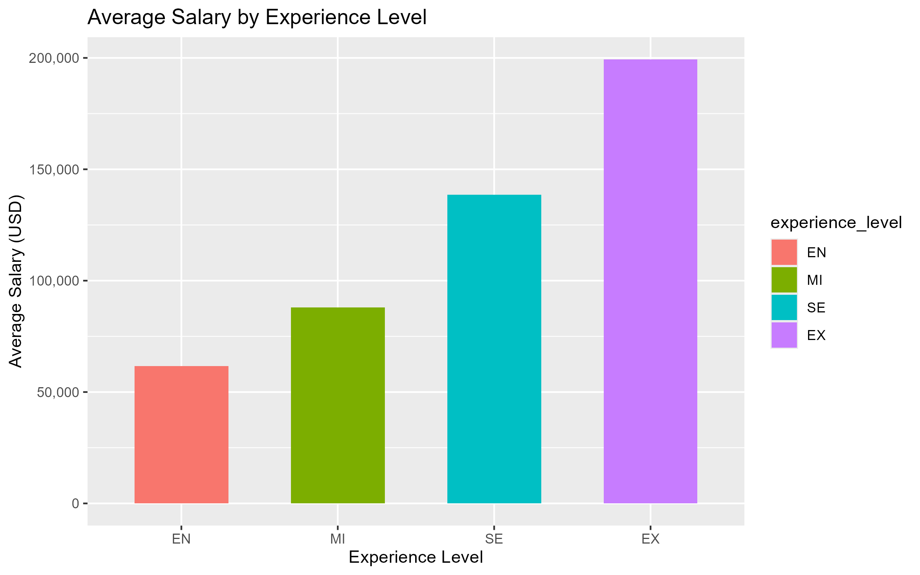
Salary by Experience Level Based on Global Averages
Insights:
Entry-level salaries are significantly lower than senior/executive salaries.
There is a sharp jump in pay between mid-level experience roles and senior-level roles.
These figures represent global averages and do not differentiate between U.S. and offshore salaries. See later slide for region-specific recommendations.
Implication:
You must pay more for top talent.
What level are you hiring for?

Slide 5
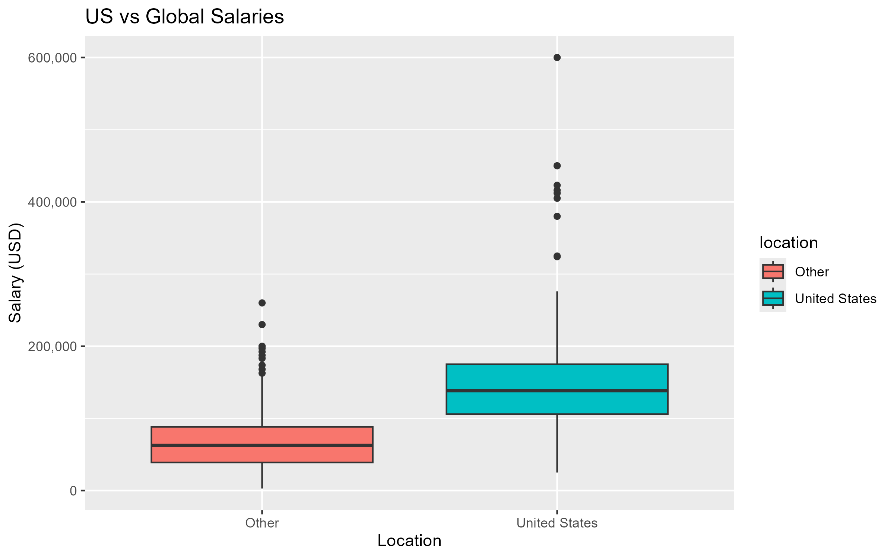
U.S. vs Global salaries
Insights
U.S. salaries are generally higher.
Global talent may offer cost savings but this varies by country.
Implication: Hiring offshore could save 40-55% but may affect availability/time zones.

Slide 6
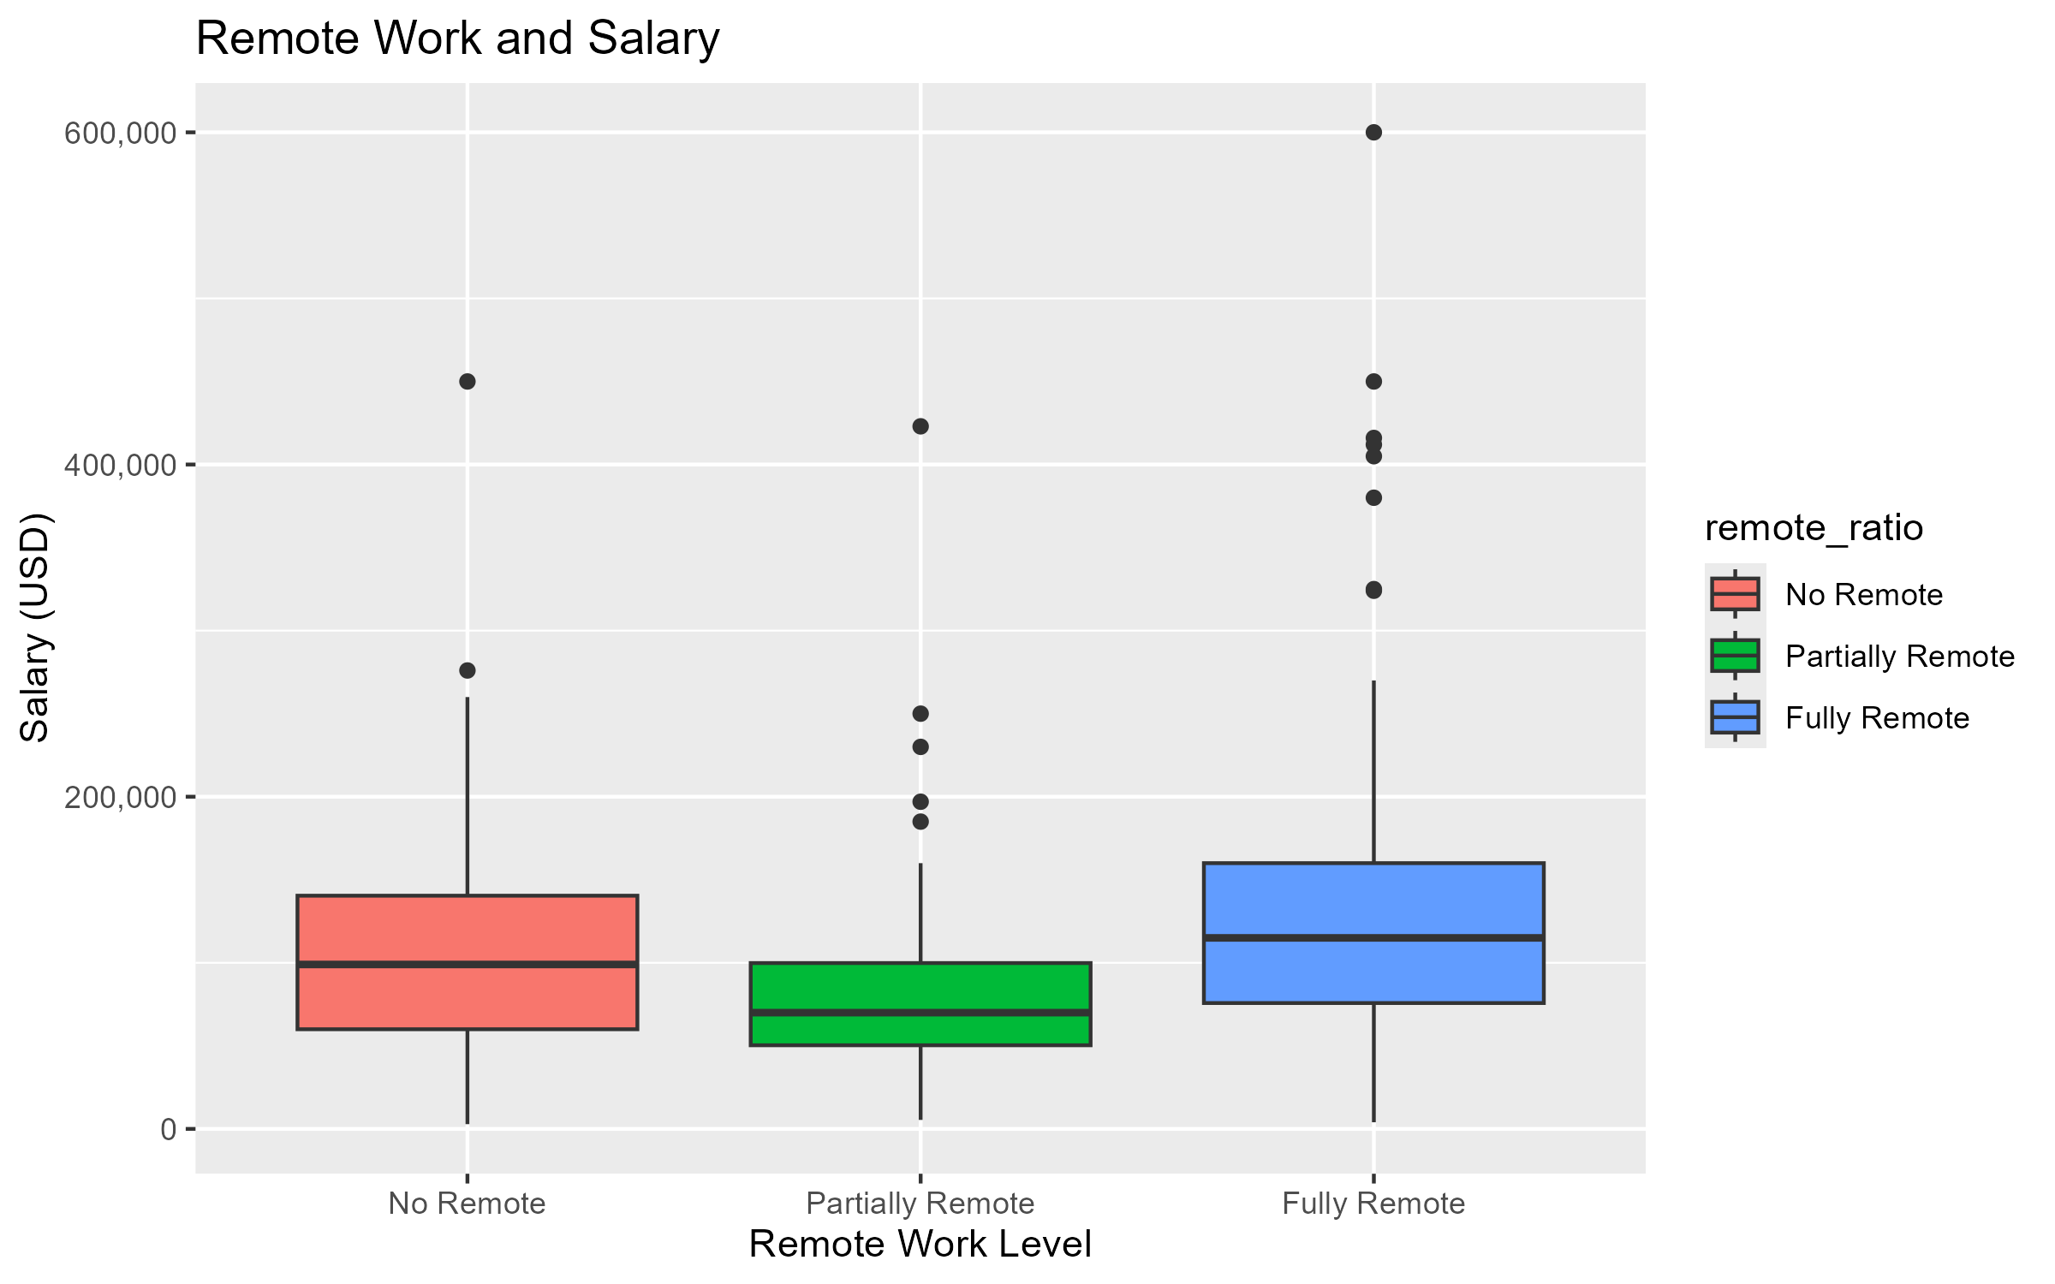
Impact of Remote work
Insights
Fully remote roles show a wider range of salaries.
Pay may reflect global competition for remote roles.
Implication: Offering remote flexibility could attract top talent.

Slide 7
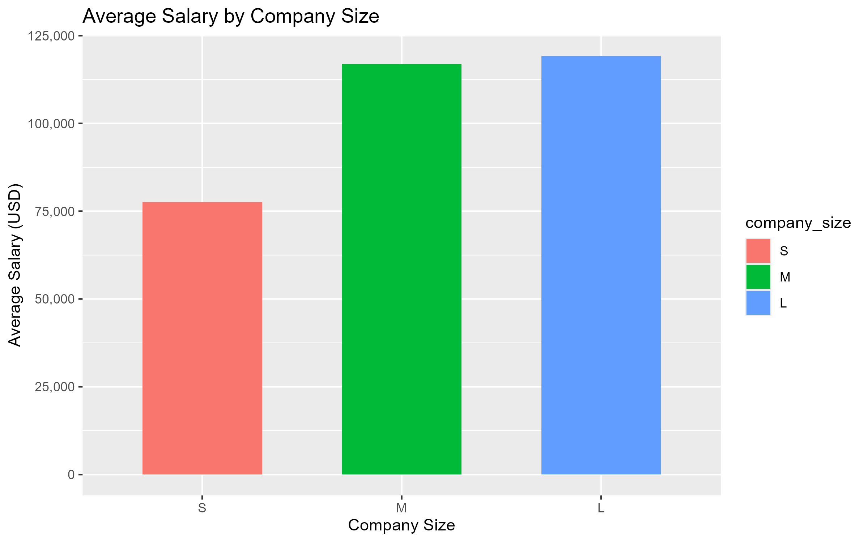
Company size and salary
Insights:
Medium and Large companies tend to pay more than Small companies.
Small companies tend to offer lower salaries.
Implication: To stay competitive, offer pay near the medium to large company range.

Slide 8
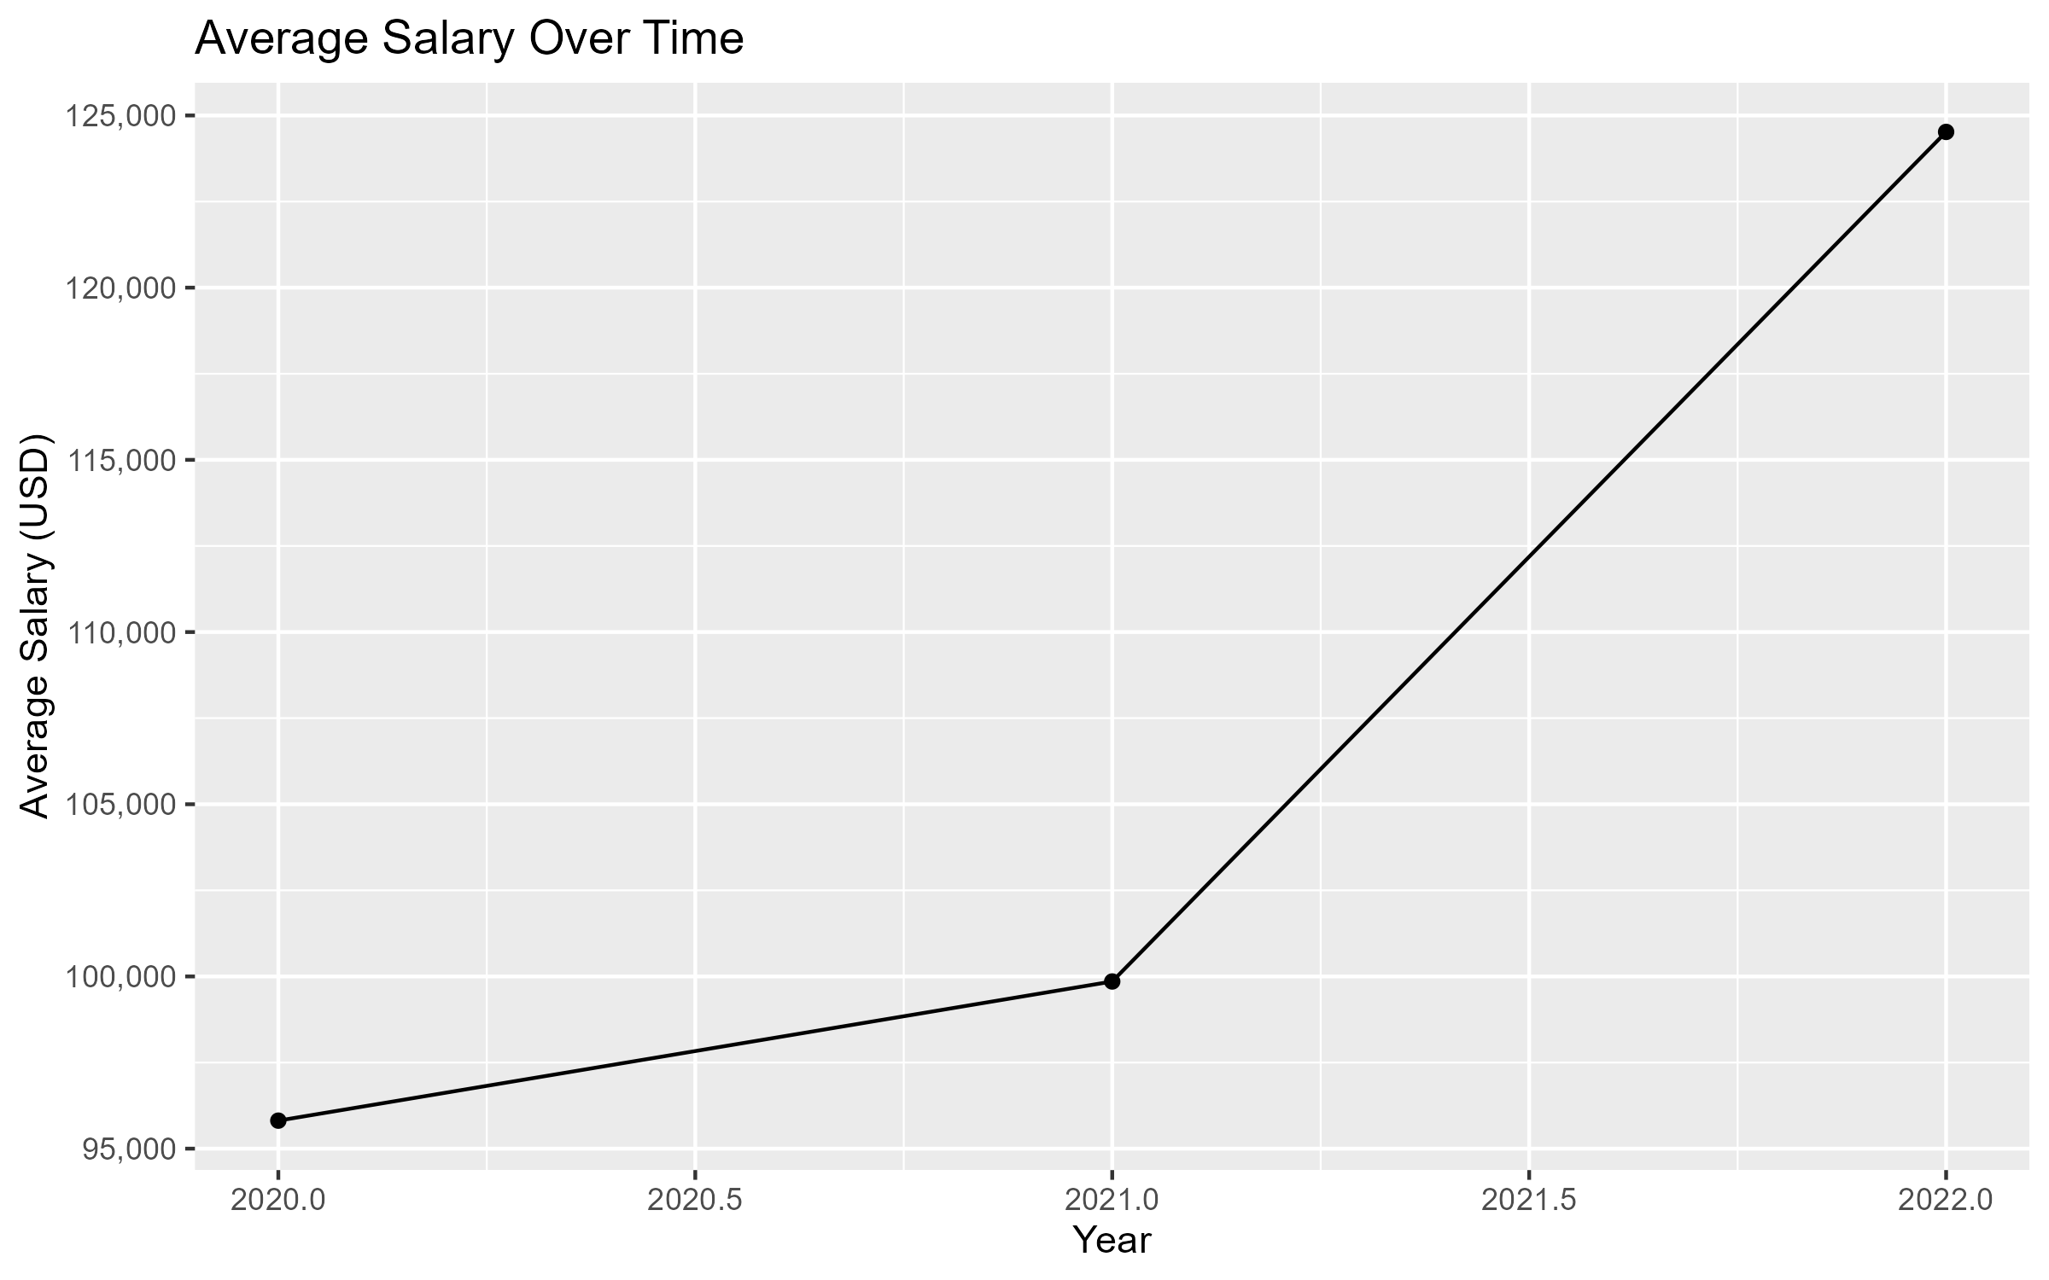
Salary Trends Over Time
The line graph depicts the average salary by work year.
Insights:
There is a steady increase in median/average salary from 2020 to 2022.
Spike post-2021 due to demand and remote hiring trends.
Implications: A delay in hiring could mean paying more later.

Slide 9
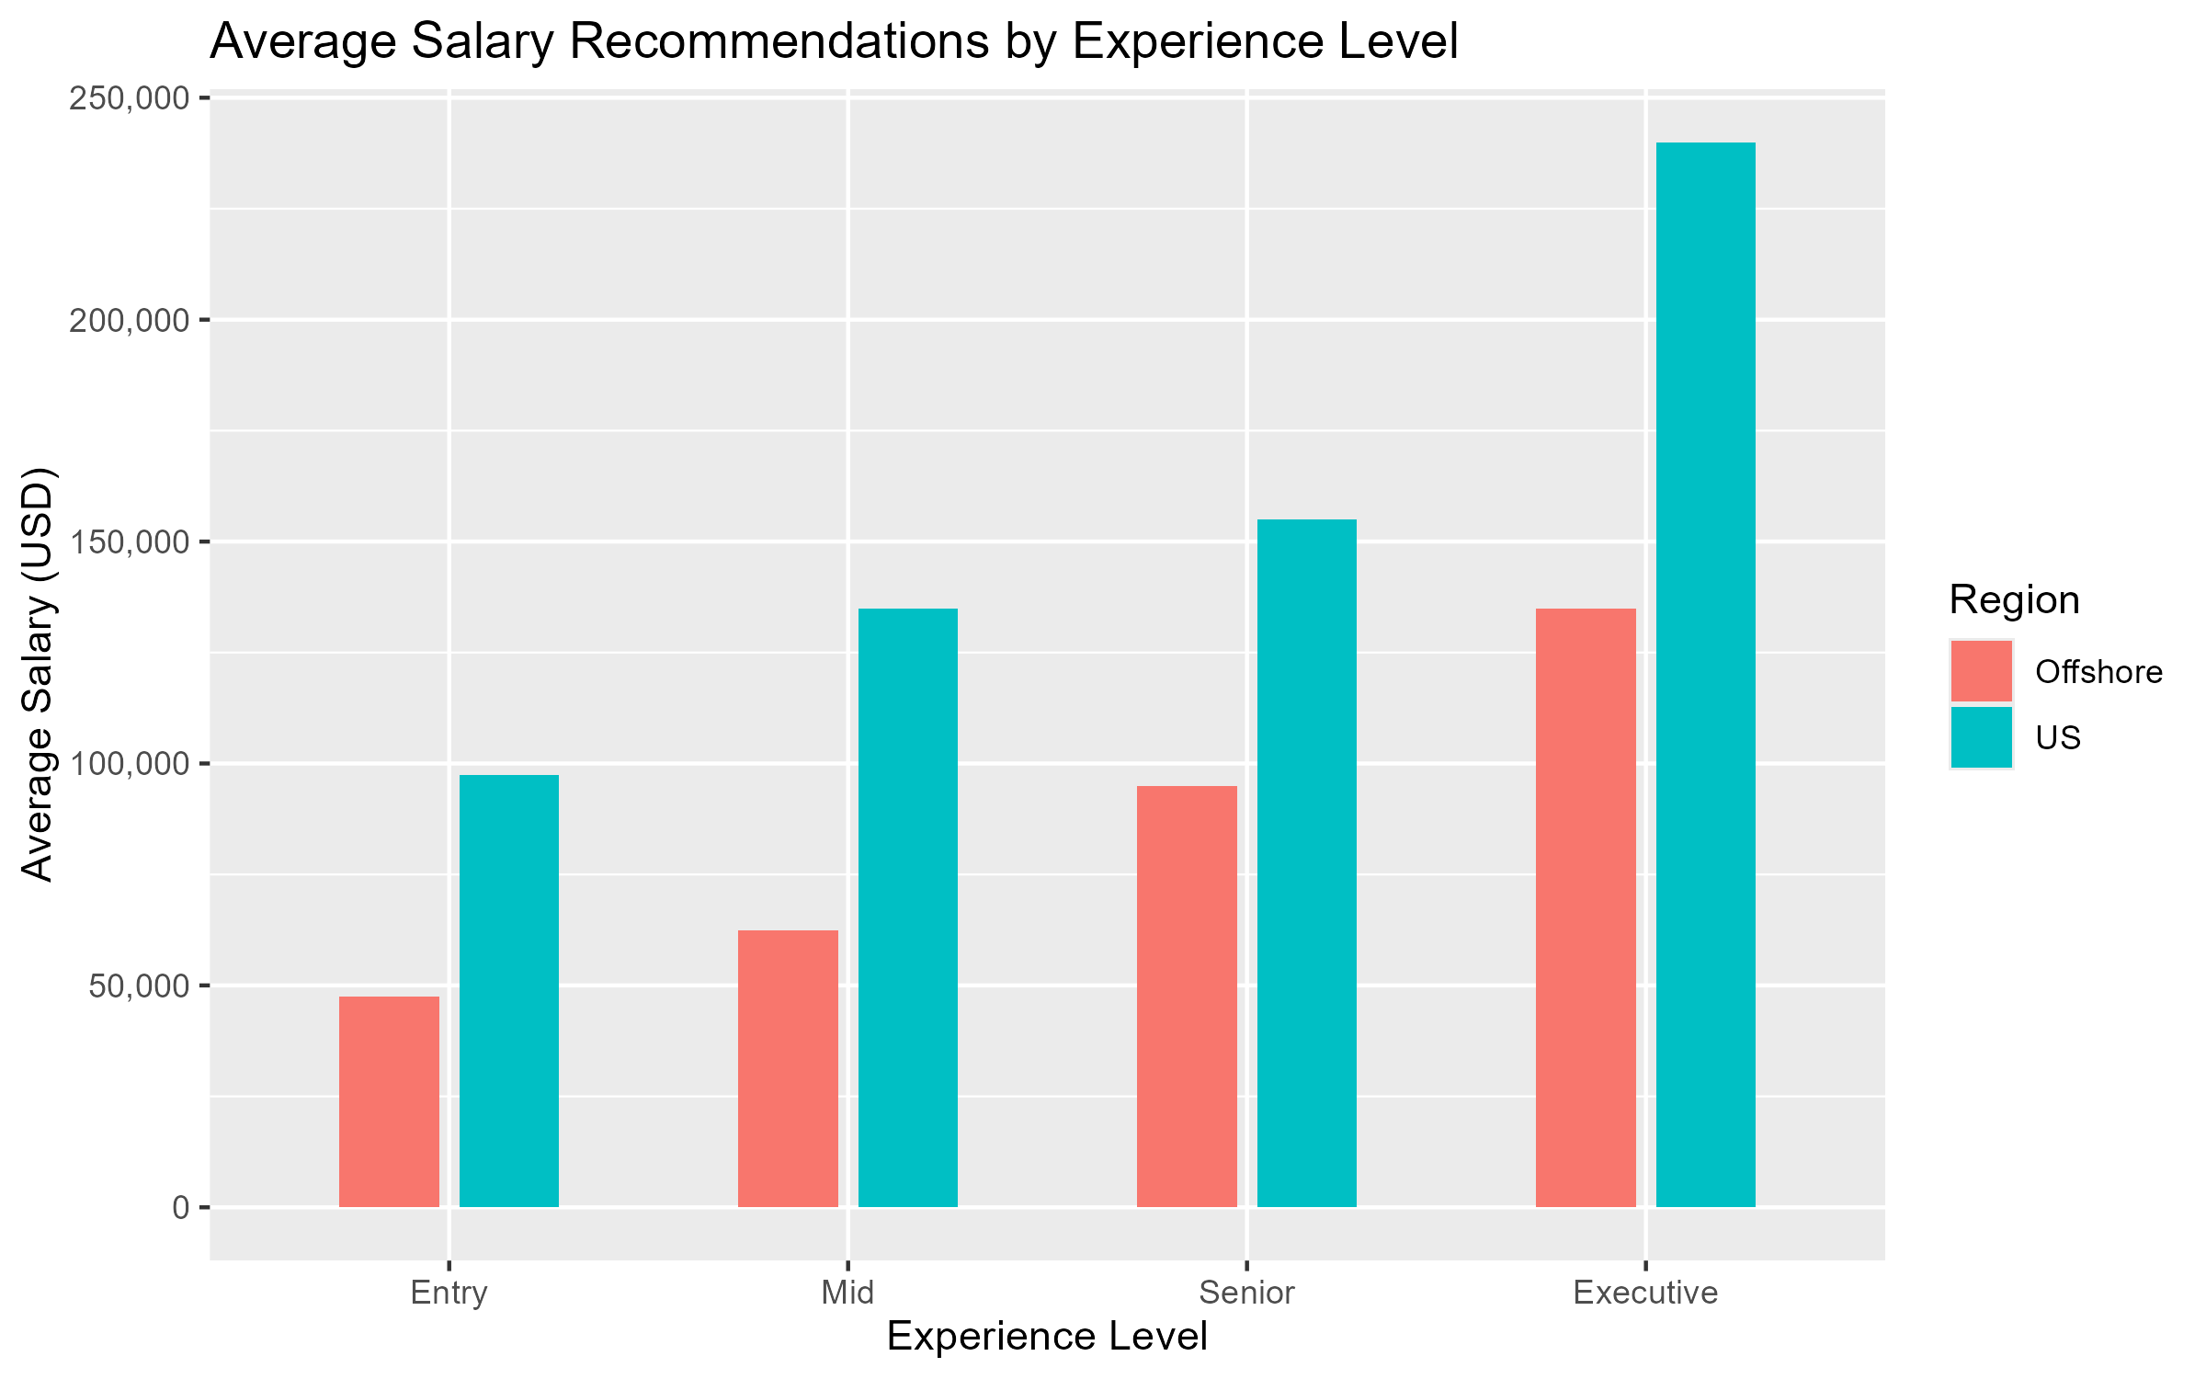
Salary Recommendations By Region & Experience
Entry-Level Recommendations
U.S.: $90,000-$105,000
Offshore: $40,000-$55,000
Mid-Level Recommendations
U.S.: $125,000-$145,000
Offshore: $55,000-$70,000
Senior-Level Recommendations
U.S.:$140,000-$170,000
Offshore: $85,000-$105,000
Executive-Level Recommendations
U.S.: $220,000-$260,000
Offshore: $120,000-$150,000

Slide 10
Next Steps
Review internal budget
Decide on hiring location
Finalize job description and benefits
Start recruiting with competitive salary ranges
Reassess yearly to stay aligned with the current market

